Slide 1
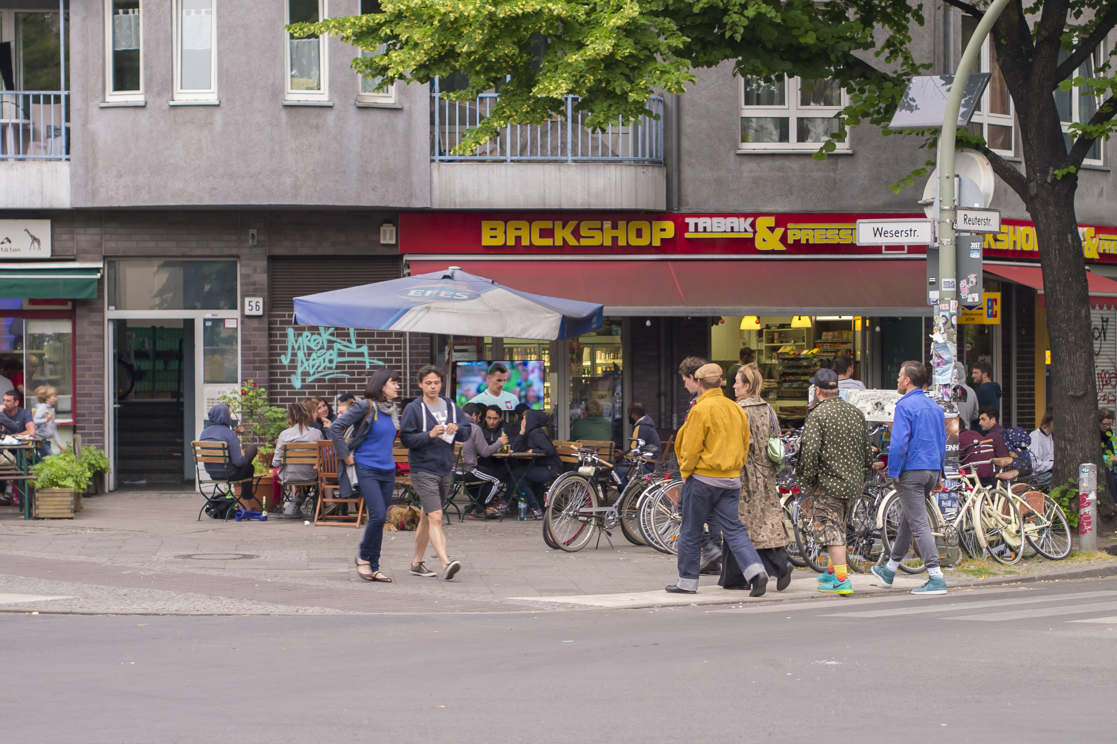
Airbnb apartment?
Tourist attraction?
Tourists?
Locals?
Trolley cases?

